Slide 1
Coding (per inventori di mondi)

Slide 2
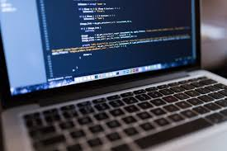



Computers are everywhere!

Slide 3
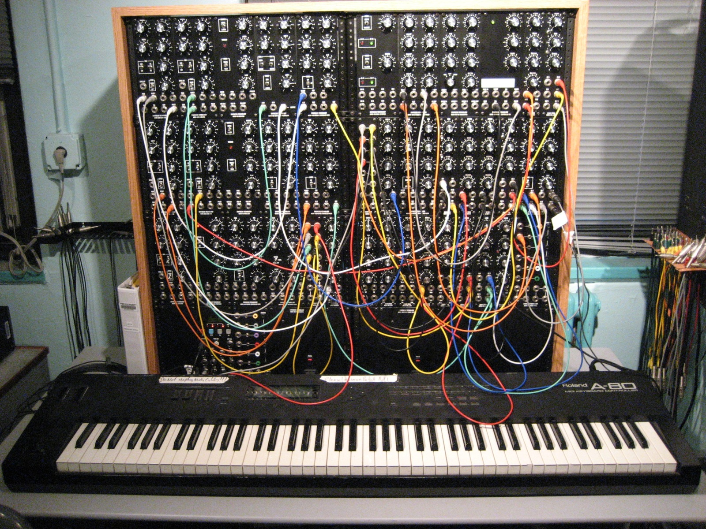
Computers are programmable!
Electronic circuits can do many (every?) things, if properly configured
But configuring them is HARD for humans!

Slide 4
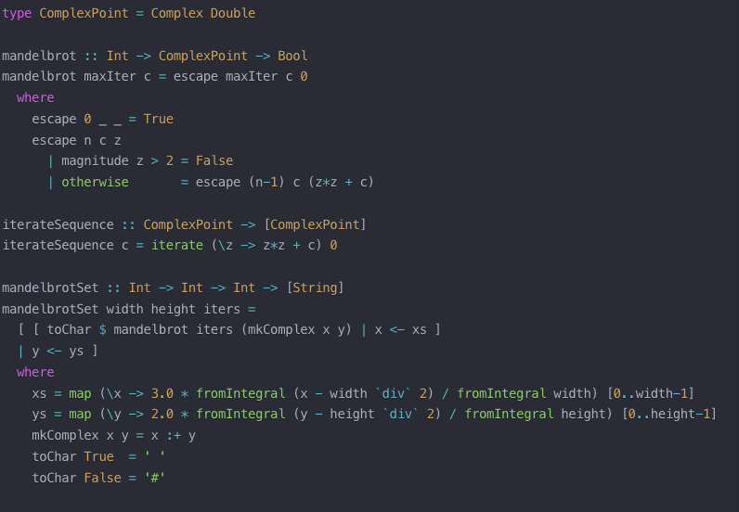
Programming languages
Electronic circuits can do many (every?) things, if properly configured
But configuring them is HARD for humans!
So ad hoc languages were invented, to meet in the middle!

Slide 5
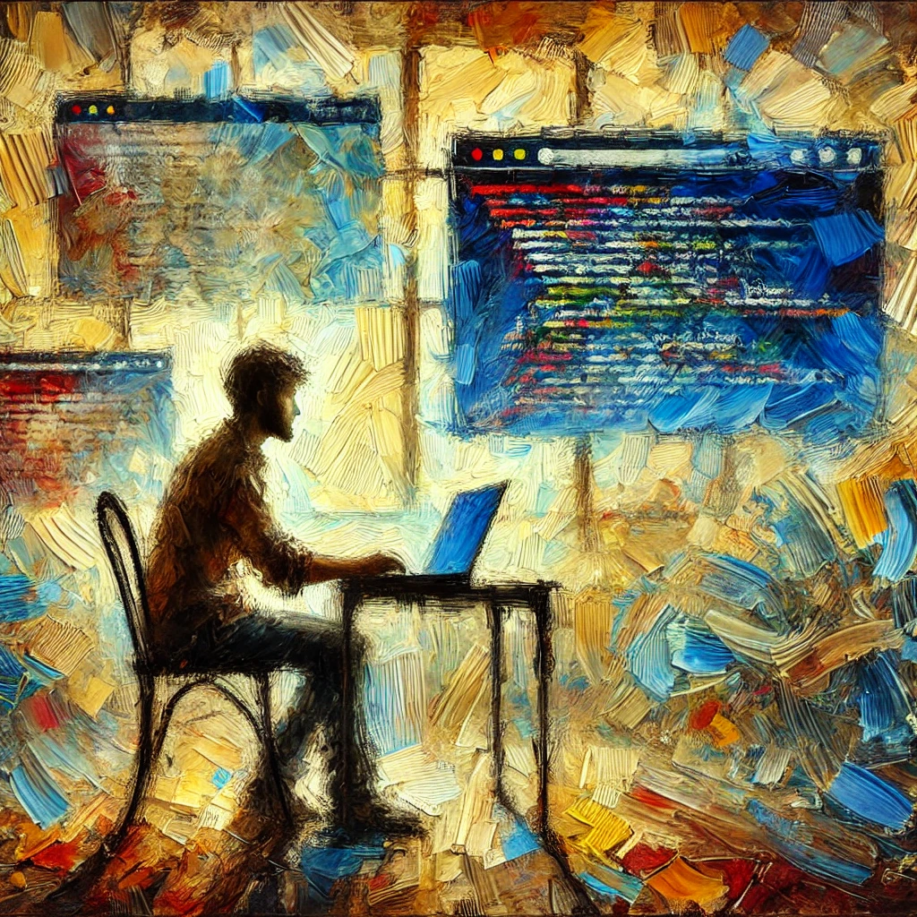
Coding
“Coding” means speaking those special languages
Not only to talk to computers: it can also be a tool for thinking!

Slide 6


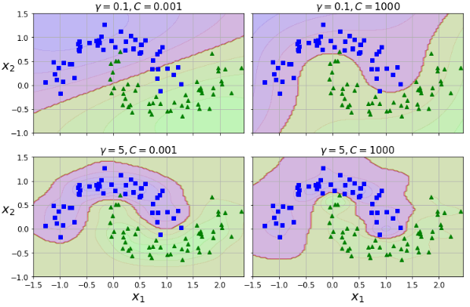
Python
A welcoming a friendly language…
…but also very powerful!
We will learn it to create new worlds!

Slide 7
Objections?
"Just tell ChatGPT what you want in plain English, and it'll code for you!"
But will it, really?
Maybe coding isn’t just a way to program, but a thinking tool
Want an informed opinion in the debate?
Then learn to code yourself!

